Slide 1

GroupGram
Social media application
Supervised by
Dr. Doaa Saad

Slide 2

Project Idea

Slide 3
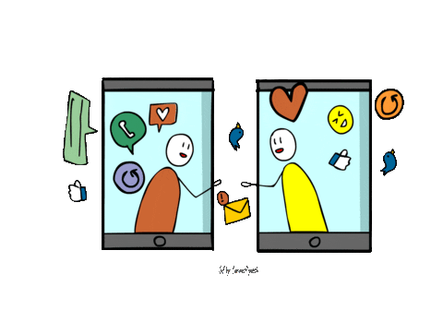




Project Idea
Mobile Phones
Affects a large scope
Making life easy
Applications
Communication

Slide 4

Problem Statement

Slide 5
Problem statement
Importance
2018
36,096
Deaths
36,835 Deaths
2017
37,473 Deaths
The number is very large so we must help each other to reduce it and be safe at the roads

Slide 6

Problem statement
Importance
Making a community
For car lovers
The Goal is to create an environment
where people can help each other with their car problems

Slide 7

Problem statement
Importance
Creating posts
Selling products in the shop
Creating problem posts
Chatting with each other
Creating an environment for people
to communicate with each other

Slide 8


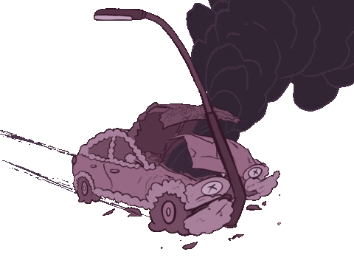
Problem statement
Importance
Create a problem post
Is your car broken suddenly ?
Then people can easily know your
Location and come to help you

Slide 9

Related Apps

Slide 10
Analysis of existing systems
Carefer
Asale7lak
Morni

Slide 11

Project Objectives

Slide 12
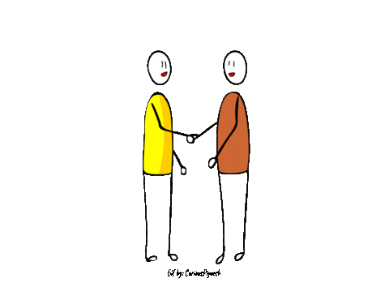
Project objectives

Slide 13

Implementation

Slide 14

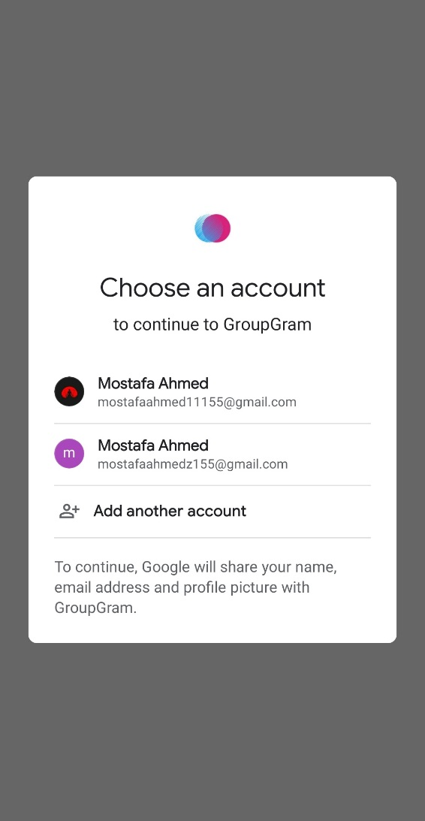
Implementation
Sign in
Sign up

Slide 15
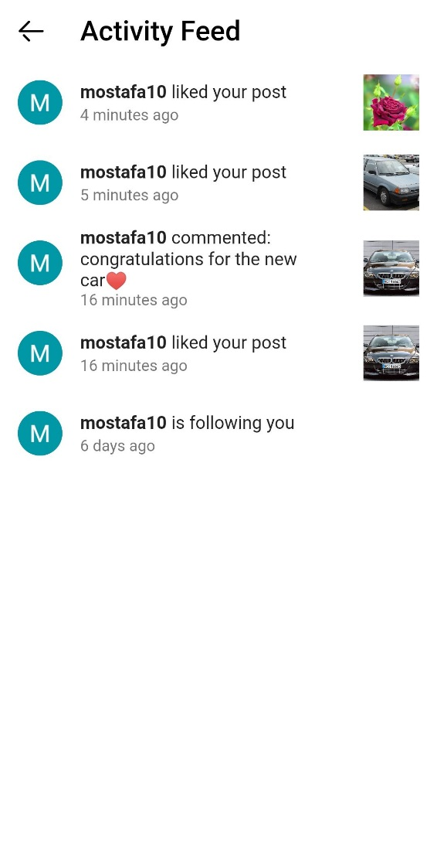
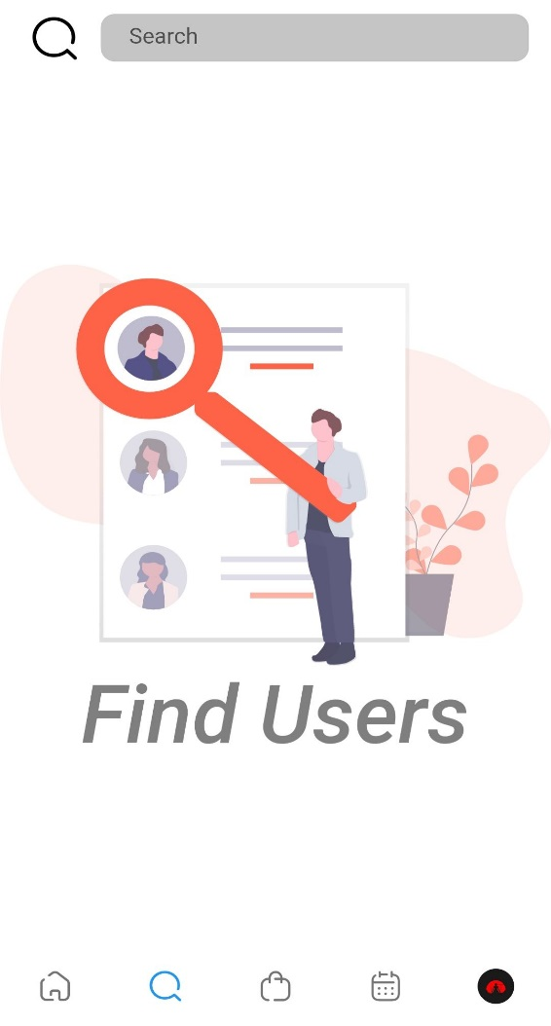
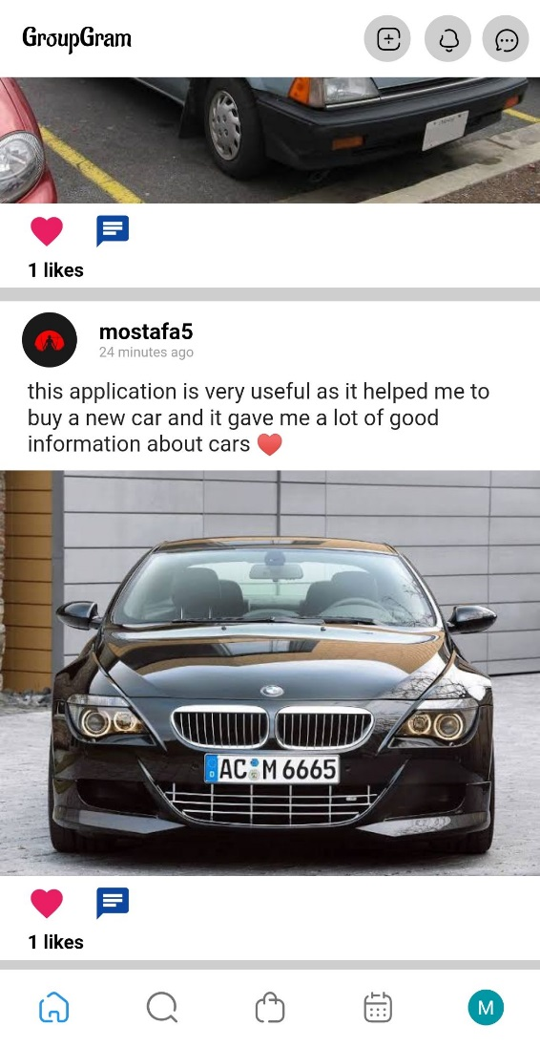
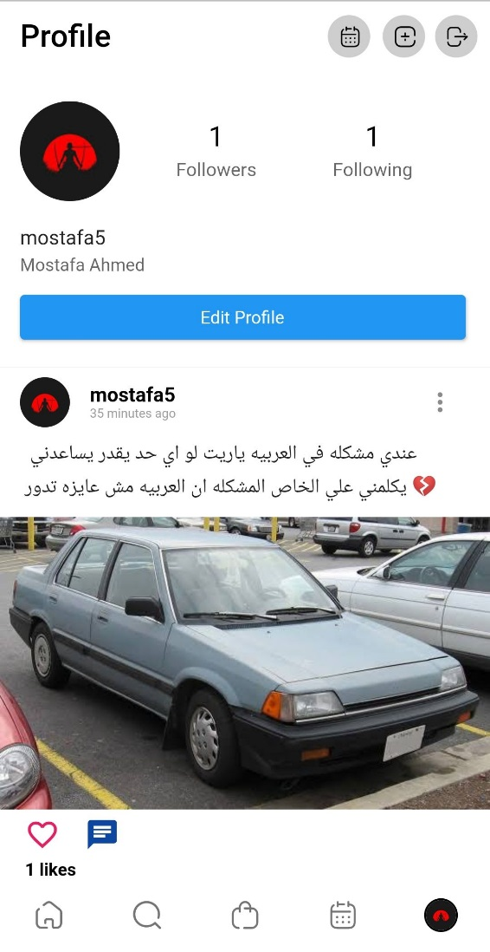
Implementation
Home page
Profile
Search user
Activity feed

Slide 16
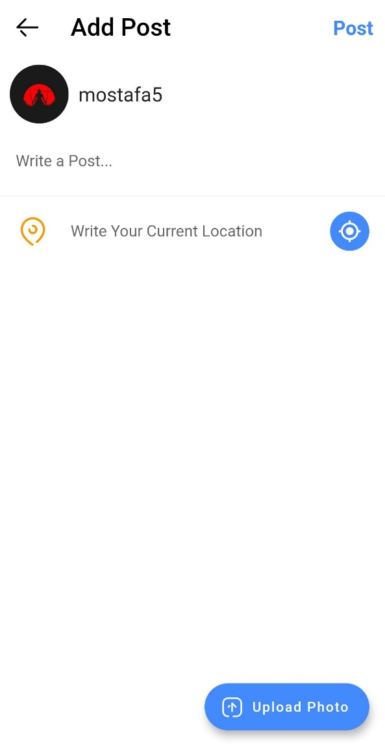
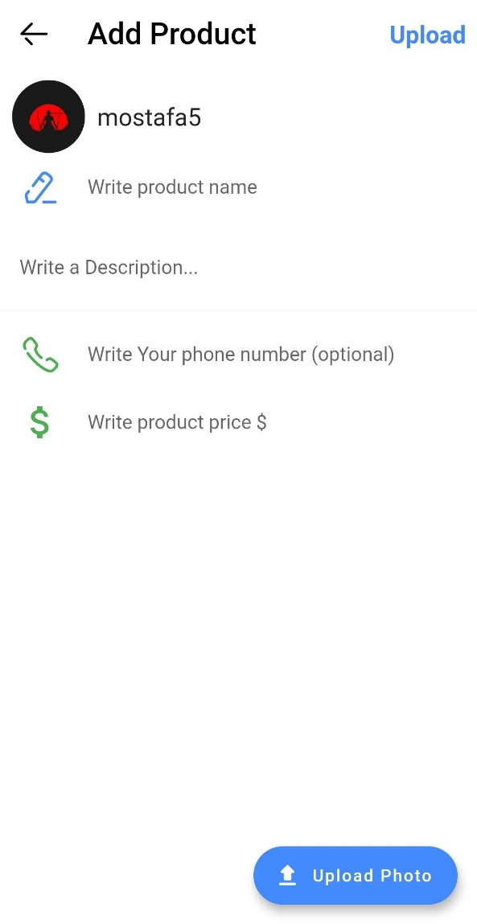
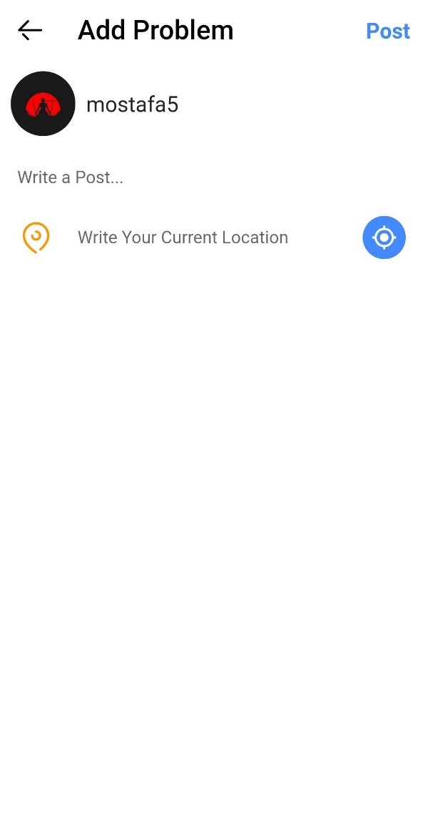
Implementation
Add post
Add product
Add problem

Slide 17
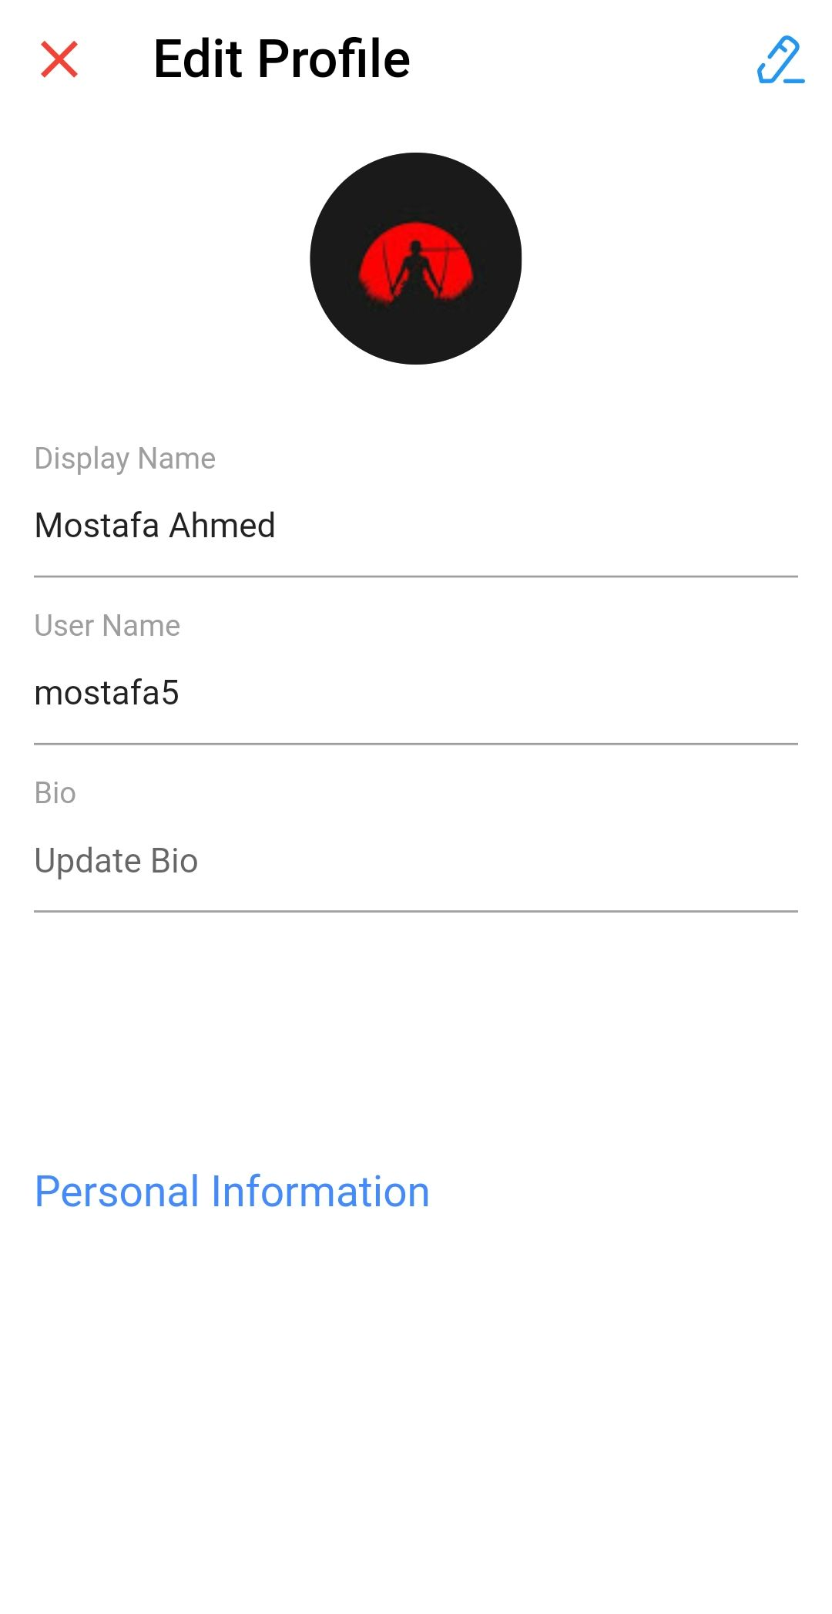
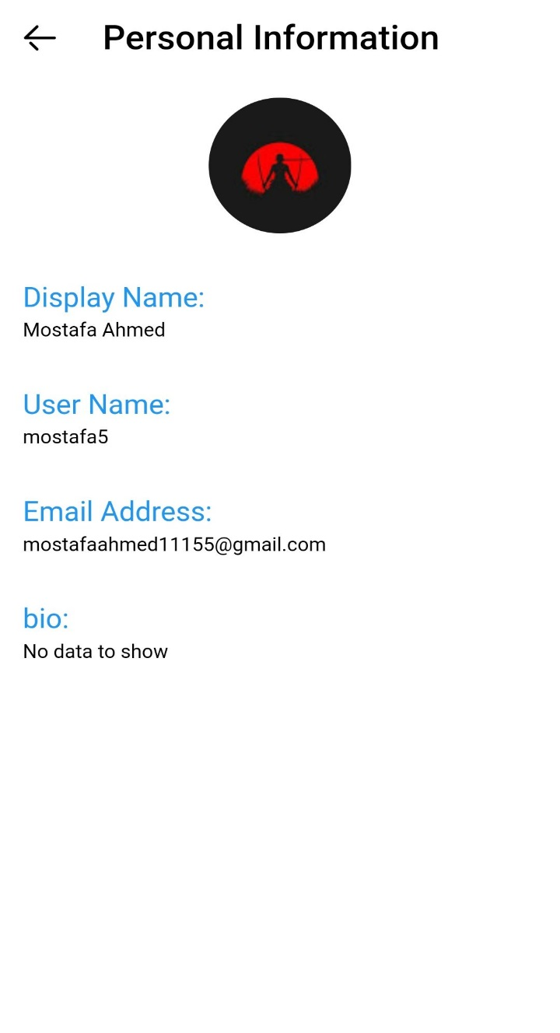
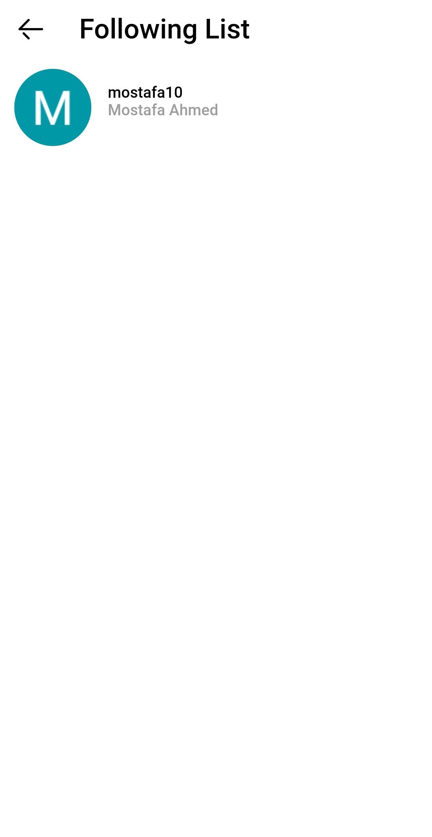

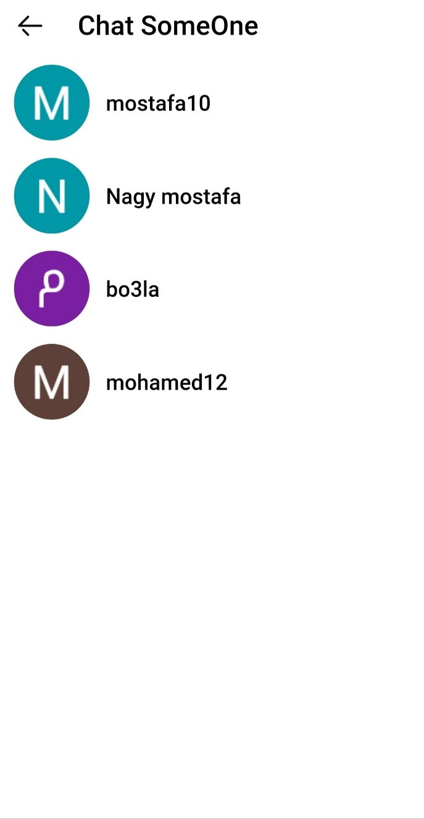
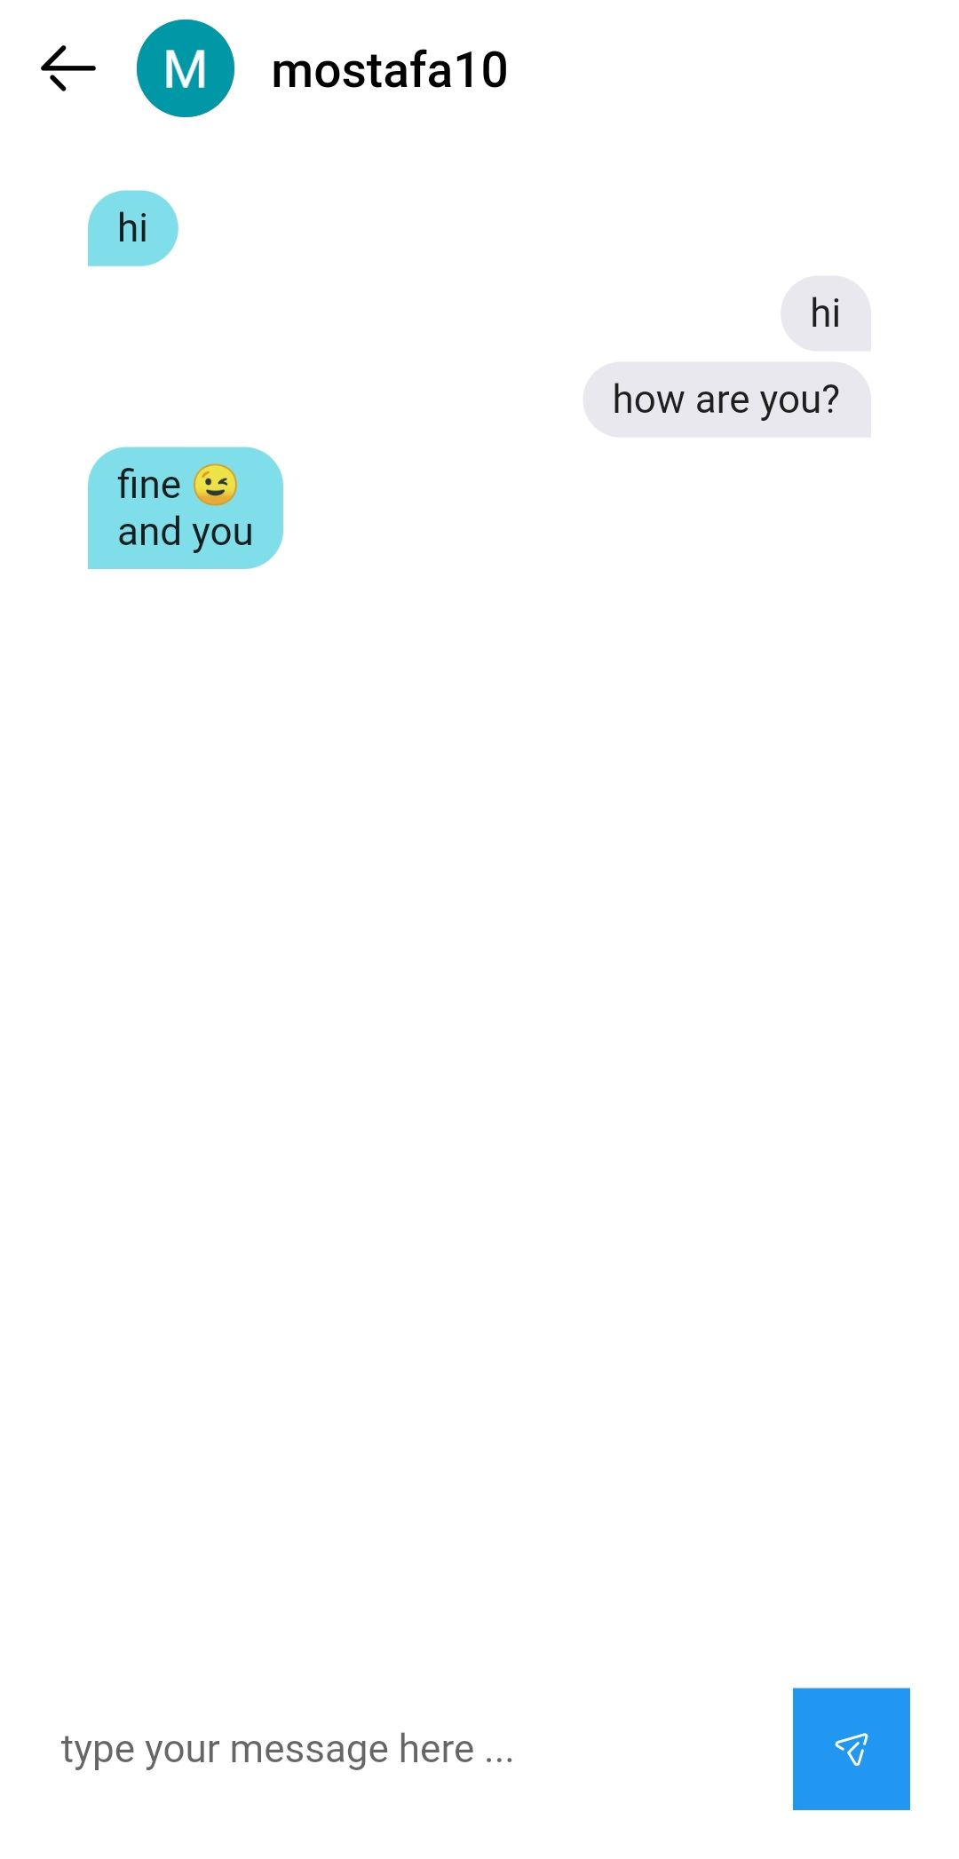
Implementation
Chat
Chat someone
Followers list
Following list
Edit profile
Personal information

Slide 18
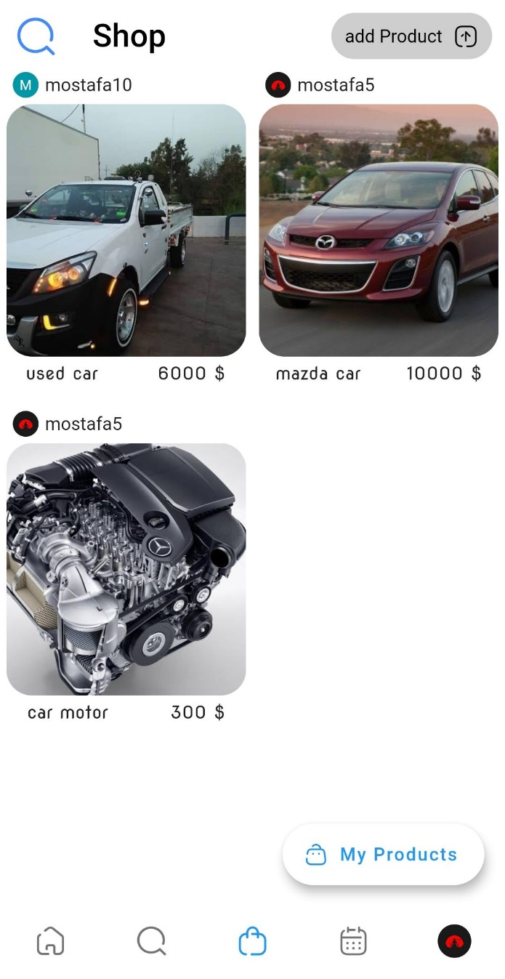
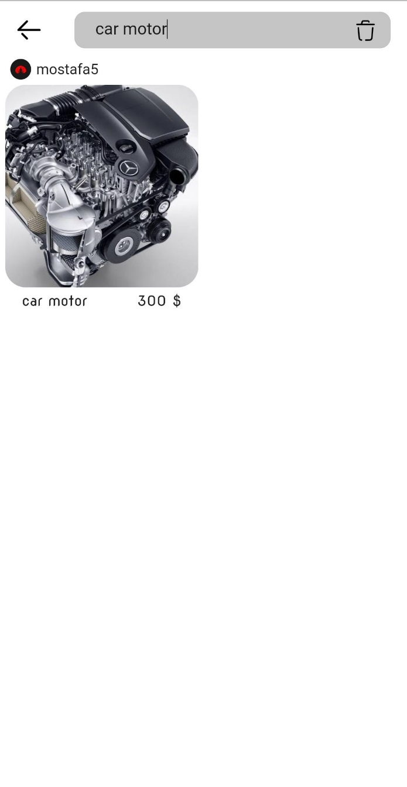
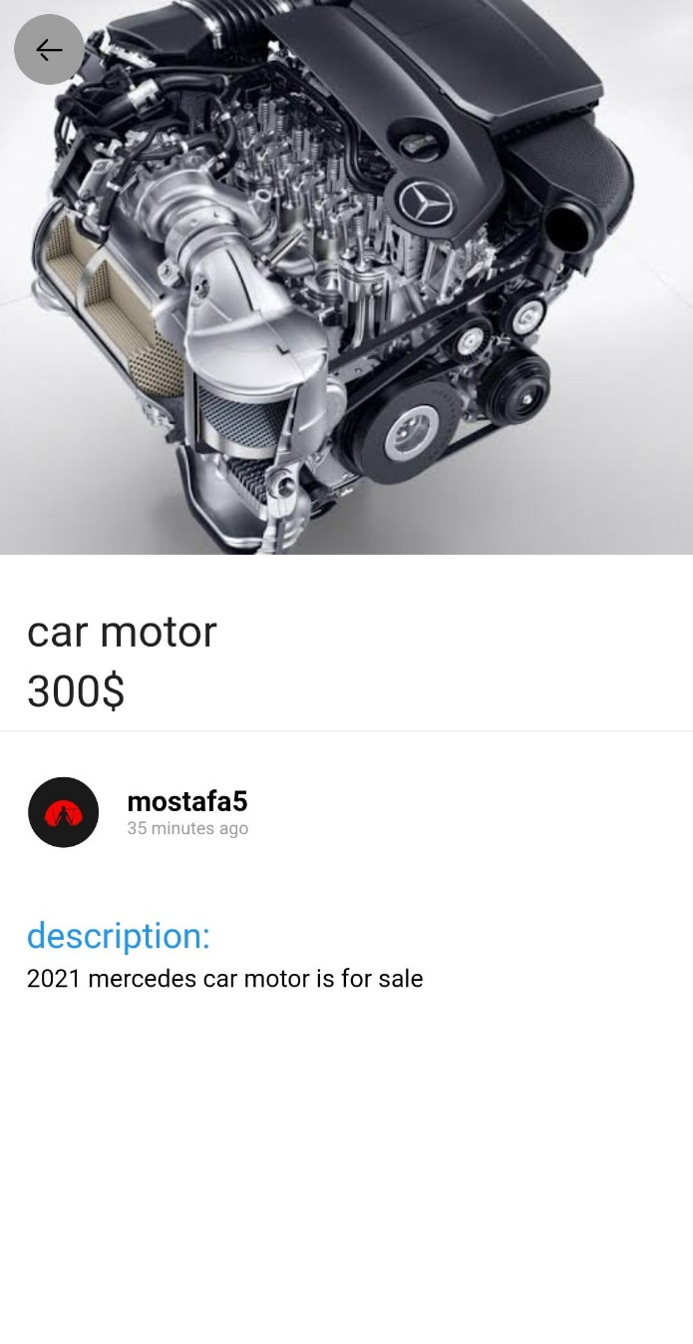
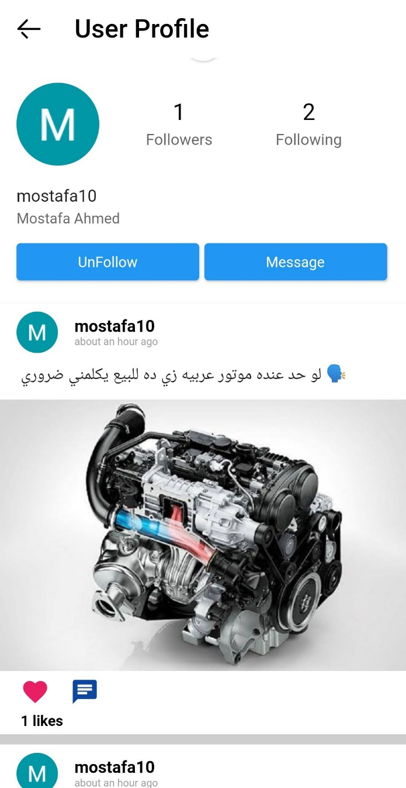
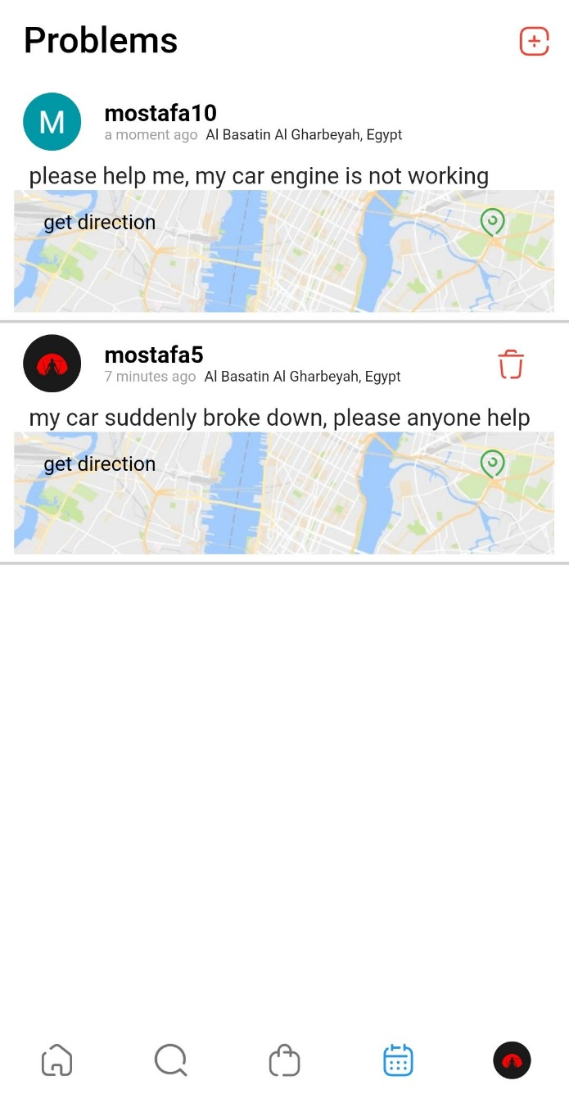
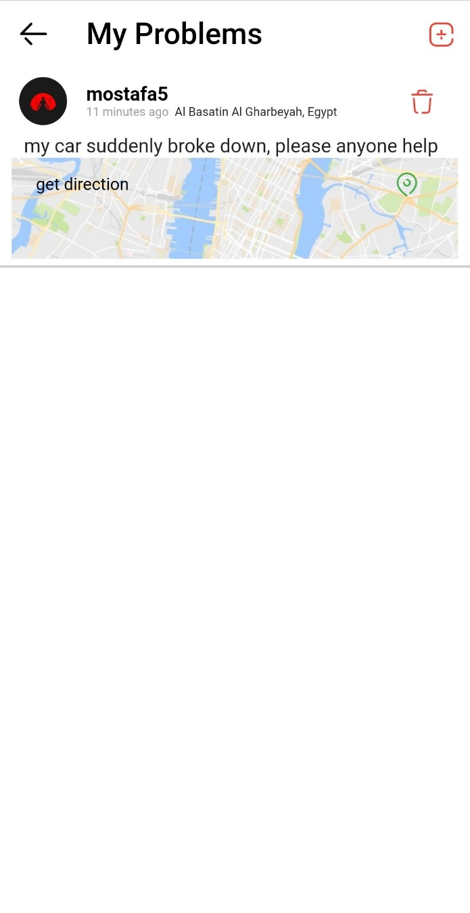
Implementation
Shop
Search product
Product details
Show user profile
All problems screen
My problems screen

Slide 19

Tools

Slide 20




Tools

Slide 21

Demo

Slide 22

Future Work

Slide 23




Future Work
Fingerprint Lock Screen
Chat improvement
2
4
Hire driver
Integrated map

Slide 24

Project Contribution

Slide 25


Contribution
Technical side
Human side

Slide 26

Conclusion

Slide 27
Conclusion

